Slide 1
COMP-SCI 5565 Assignment 3
Stat Learning:
Features Selection & Classification
Analyst: Joel Vinas
Notes:
These slides and the colab code are available via GitHub at the link provided during the submission.
To make the Word Doc, I took screenshots of the Google Colab while in Slides mode and pasted them into a single-column table within MS Word.

Slide 2
Features Selection & Classification
Section 1: Cross-Validation & Bootstrap
Automotive data
From ISLR2 - Introduction to Statistical Learning
Section 2: Classification
Wisconsin Breast Cancer Data
All resources available on GitHub

Slide 3
Cross-Validation & Bootstrap
The test rates for a quadratic exceed those of the Cubic.
Although not required, the linear values are provided for reference
Instead of ½, I’ve selected 1/5, 1/7 and 1/9 as the new ratio.
Although the instructions say to use the best performing (quadratic), in order to compare the differences, I’ve written the code to run against all 3 poly fits
This is run as part of a loop for ease of code.
It would have been nice to have this in a table or chart as opposed to the text
This would have shown the curious dip that the quadratic results produced with the 14% (1/7) ratio – while the other poly fits had clearly growing (or shrinking) values
For question 3, rather than a comparison of mpg vs horsepower, I used mpg vs weight
The values here were fairly consistent across the spread
For the 5-fold and 10-fold cross-validation in question 4, I compared mpg to acceleration
Although the mean isn’t calculated, the values across the 8 runs were fairly consistent
For question 5, I iterated across a list of sample sizes to make the code a bit more repeatable
I also spent a bit of time to determine how to derive and store the values of the bias and standard deviation to produce better reporting
The original sample size was 392 vehicles. As the samples approach this quantity, the error decreases, increasing as the total samples drift from this value. This aligns with how the bootstrap method works.

Slide 4
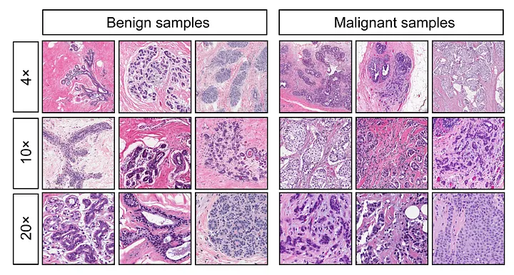
Section 2: Classification
During the discovery phase, I learned that.
The Wisconson Breast Cancer data (abbreviated throughout the code as wbcd) was a dataset, available through Kaggle, which were computed from digitized images.
Notably, the data was separated by planes, which my code defines as “Dimensions”.
Each record relates to a specific sample, but since each plane distinctly assesses the 3-dimensional space, I’ve chosen to complete this exercise by comparing the planes (or dimensions) independently.
Each sample was either M for Malignant or B for Benign.
Practically speaking, since we’re talking about cells, there isn’t an up or down. There isn’t a way to practically align the sample cells so that each dimension (1 thru 3) has innate significance.
Notes:
https://medium.com/analytics-vidhya/breast-cancer-diagnostic-dataset-eda-fa0de80f15bd

Slide 5
Classification
Ingestion:
The first step was to provide access to the data file directly
Adding headers to this raw dataset
Then forcing the “Diagnosis” value to numeric (1) for values of M
I flipped a coin to select a 5-fold analysis, and added this as a field to the raw dataset
I then split the dataset, by columns, into Dimension 1, 2, and 3 for the three planes, ensuring that each subset had consistent headers
The head (or first 6 rows of data) are displayed to better grasp the data used.

Slide 6
Classification – Question 1
To determine if the distributions are well suited to classification tasks, I produced a pairs plot for each of the dimensions.
Following the guide, I then iterated through the 3 dimensions to display the summary of the fit of the generalized linear model
It is interesting to note that, as predicted, different parameters displayed distinct coefficients and z values, by dimension
Texture was consistently a top parameter

Slide 7
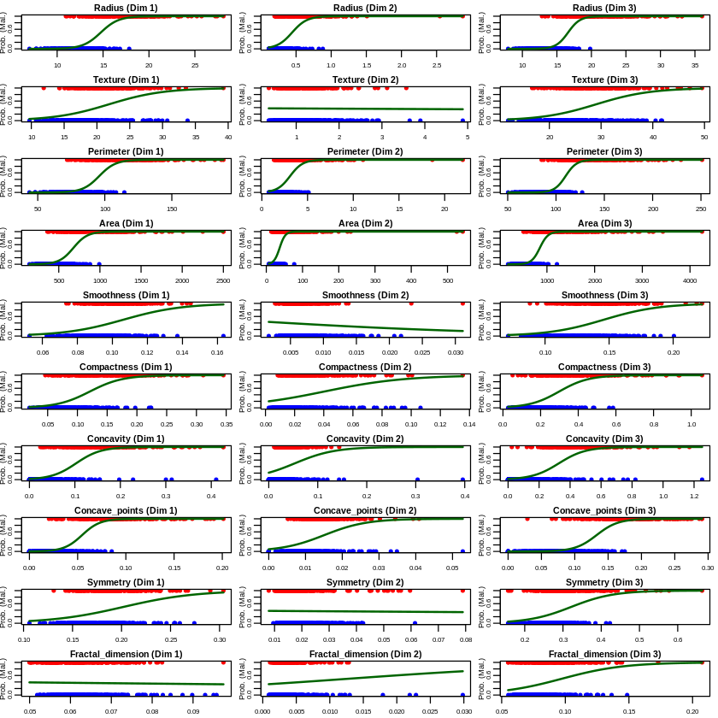
Classification – Question 1
It took a bit of wrangling, but I managed to produce a single chart which showed a side-by-side comparison for each parameter, of the plot mentioned in the geeks for geeks link.
The variation in the sigmoid across parameters and dimensions really highlights the difference of measurements in each dimension.
Again, we can’t presume that Dim 1 vs Dim 3 has significance – the cells are simply recorded based on the random rotation they had when scanned. They weren’t pre-rotated to be consistently “facing up”

Slide 8
Classification – Question 1
Following the guide in Geeks for Geeks, I continued with the analysis, providing the summary of fits for the generalized linear model’s coefficients, and ten tests of the probability of a response
Rather than running one binary test for each parameter for each plane, I ran this with all parameters.
This was done mostly to push my code skillset and to see the results which would be knowingly an overfit.
I then displayed the confusion matrix for the results
The report concluded with the mean of the prediction
These steps were repeated independently for each of the dimensions (or planes)
Again, it was interesting to note the variation of the coefficient and significance as the model sampled each of the sub-datasets.
At first glance, the results of this logistic regression were excellent, with means of 94.8%, 89.9% and 98.0% for the three dimensions.
We discussed in class how this was due to overfitting, so I re-ran the analysis, using the k-fold technique, training against 1/5th of the data and testing against the remaining 5th
Although this method results in much more pessimistic results, it was clear from the miserable test results vs the remarkable training results that the model was overfitting using the logistic regression method mapped to all parameters.

Slide 9
Classification – Question 2
Following the guide, I applied the linear discriminate method.
To be consistent and fair, I did this against all parameters – just like in the logistic regression
Since my last analysis had used the 5-fold data, I repeated this method
The resulting graphs showed consistent left vs right alignment across the data samples for each of the three planes.
It was far from perfect, but it was certainly curious to see how the coefficients were fairly homogenous within a plane, but distinct across planes.
For example, for Plane 1, “Concave Points” had constantly high coefficients, for Plane 2 there were no consistently meaningful winners, and for Plane 3, “Fractal Dimension” and “Smoothness” were consistently high.
This promotes the concept that there was some meaning to the planes
It also highlights what we discussed in class - just how touchy the randomly selected k-fold data can be

Slide 10
Classification – Question 3
For consistency, I continued with the data used in the previous analysis.
I found help online for a KNN Classification and used 5 features which were selected due to their coefficients and p-values being interesting
It would have been nice to have been more objective about the feature selection, as well as have it distinct across each panel
Since we’d already broken the data into 5 parts, I used 1/5th as the test set size
After iterating through each fold of each panel, I got the mean of the results:
91.5% for Dimension 1
83.6% for Dimension 2
97.2% for Dimension 3
Although I wasn’t perfectly objective in my selection of features, it seems clear that the selected features were quite good in classifying the diagnosis.

